Slide 1
Portland Public Schools Board Presentation
May 28, 2019

Slide 2
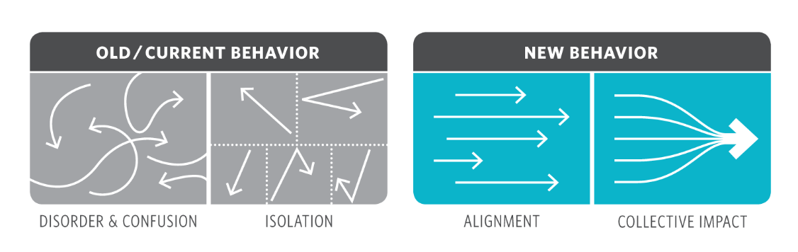
Collective Impact

Slide 3
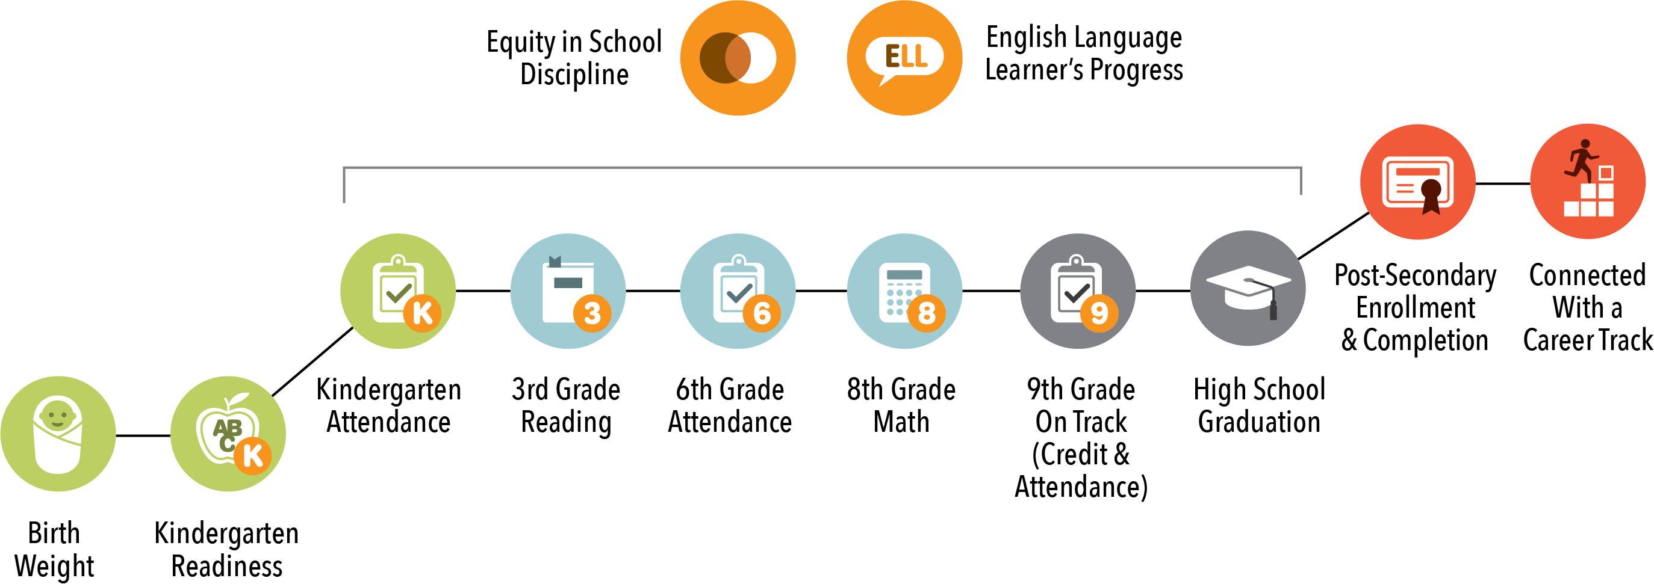
Community-Wide Indicators

Slide 4
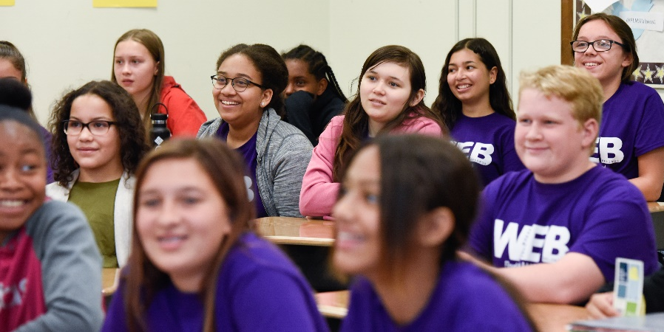
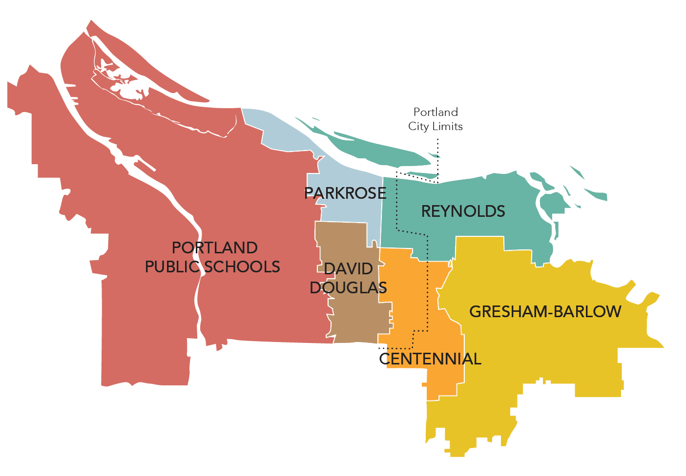
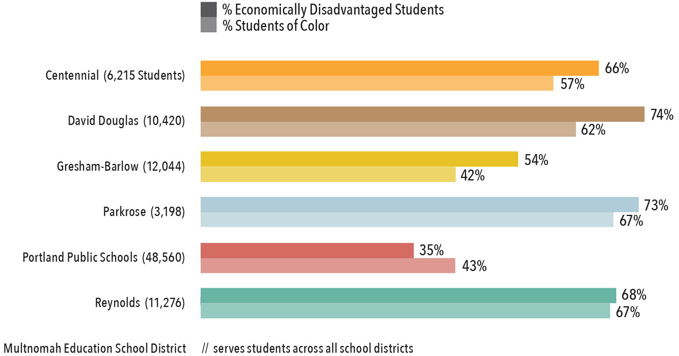
School District Demographics

Slide 5
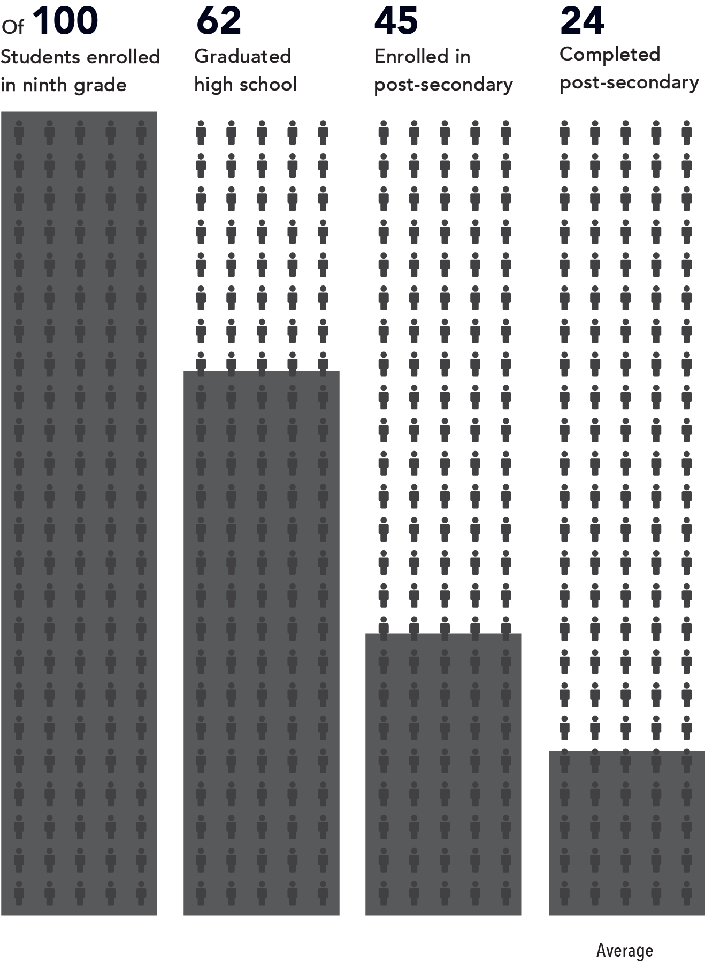
Multnomah County’s Class of 2011
And if you break down that average of 24 students who completed post-secondary by race, it looks more like:
8
American Indian/Alaska Native students
36
Asian/Pacific Islander students
13
Black/African American students
12
Latino students
27
White students

Slide 6














Our Focus Areas
Reducing Disproportionate Discipline & Building Positive School Culture
Building Bridges Into Kindergarten
Improving Student Attendance & Engagement
Helping Ninth Graders Stay On Track
Increasing Access to Post-Secondary Education
Improving Post-Secondary Completion
Forging Pathways From School to Careers

Slide 7
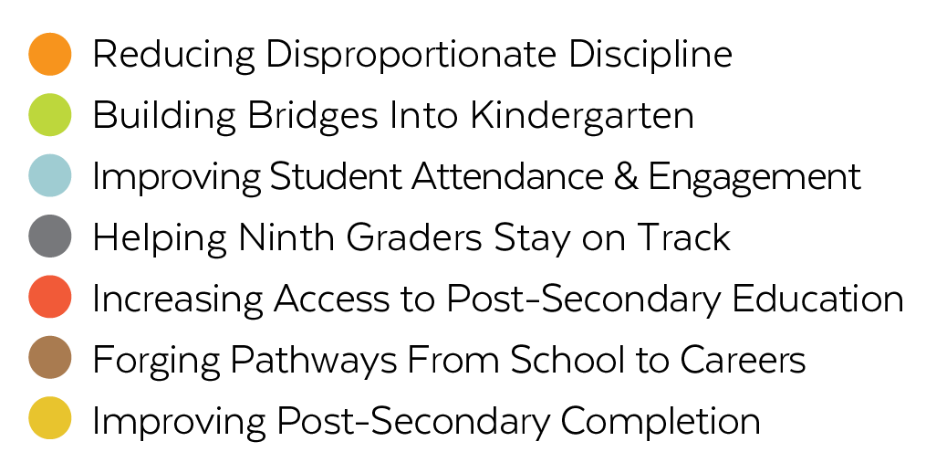
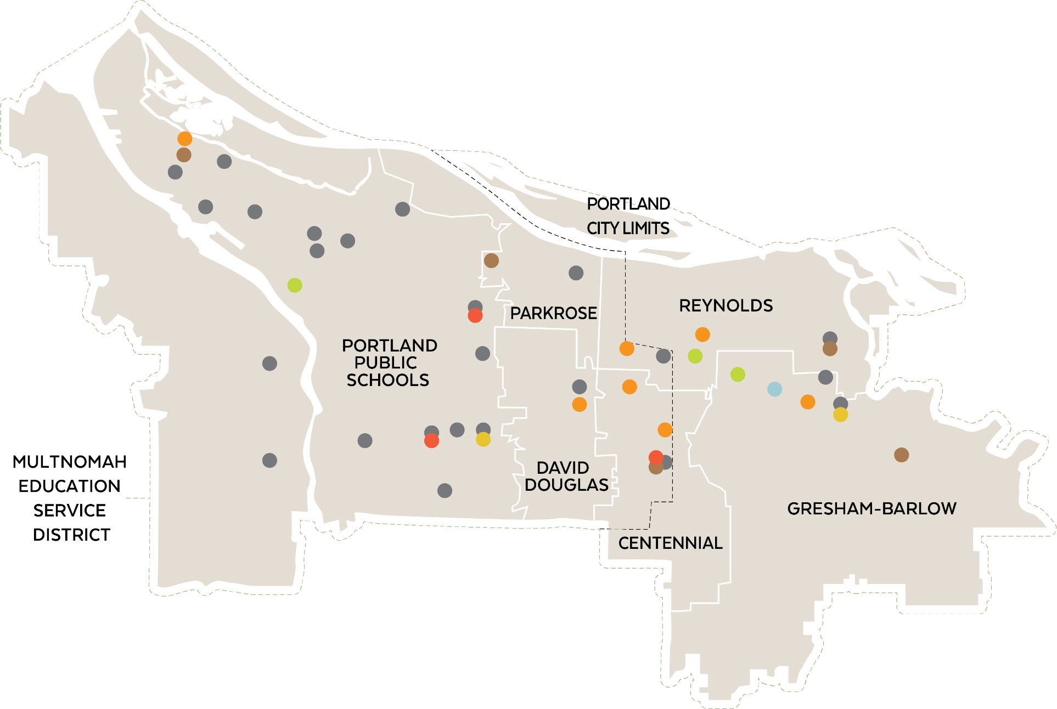
School Community Site Teams

Slide 8
School Community Site Teams

Slide 9
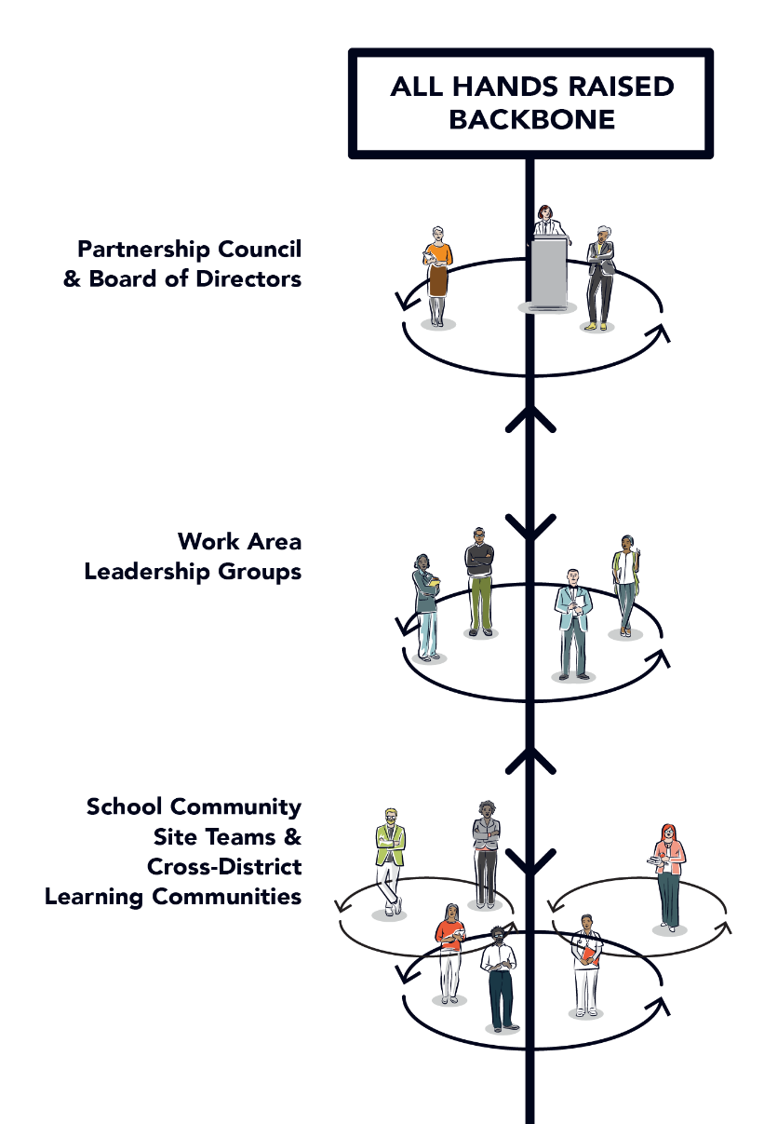
Our Structure

Slide 10
PPS Site Teams
Reducing Disproportionate Discipline & Improving School Culture
Forging Pathways from Schools to Careers in the Trades
George Middle School
Roosevelt High School
Building Bridges into Kindergarten
Increasing Access to Post-Secondary Education
Boise-Eliot/Humboldt PK-8 in partnership with Albina Head Start
Franklin High School
Madison High School
Helping Ninth Graders Stay on Track
At 17 PPS High Schools, Middle Schools & Partner Locations
Improving Post-Secondary Completion
Portland Community College SE

Slide 11
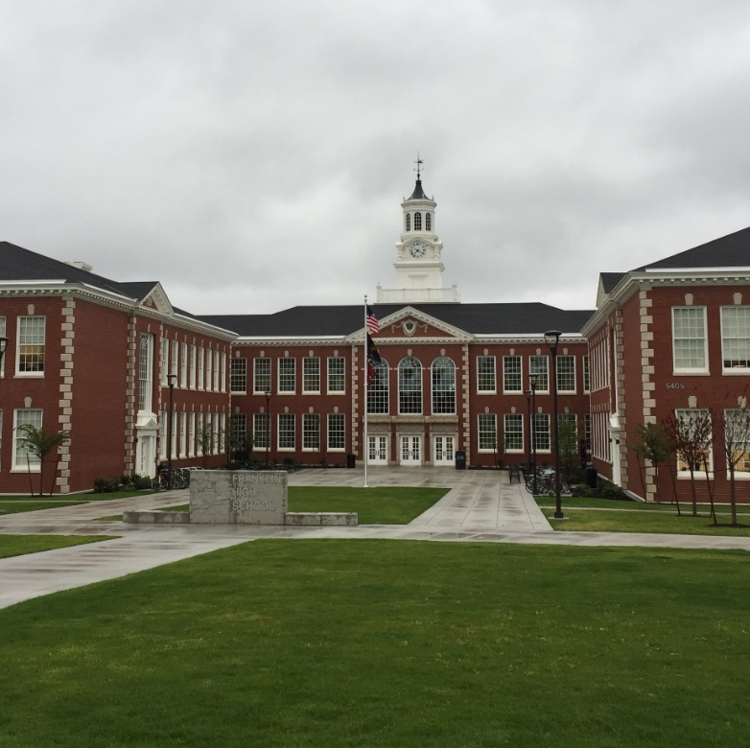
Increasing Post-Secondary Access at Franklin High
Team:
Chris Frazier, Principal
Pam Garrett, Teacher
Julie Palmer, Instructional Specialist
Holly Vaughn-Edmonds, Counselor
Desi Wolf-Myren, AVID Coordinator
Elisa Wong, Teacher
Anna York, TAG Coordinator
Mark Zimtbaum, Social Studies Teacher
Amber McGill, SUN Site Manager, Impact NW
Jen Piper, Dean of Instruction, Portland Community College SE Campus

Slide 12
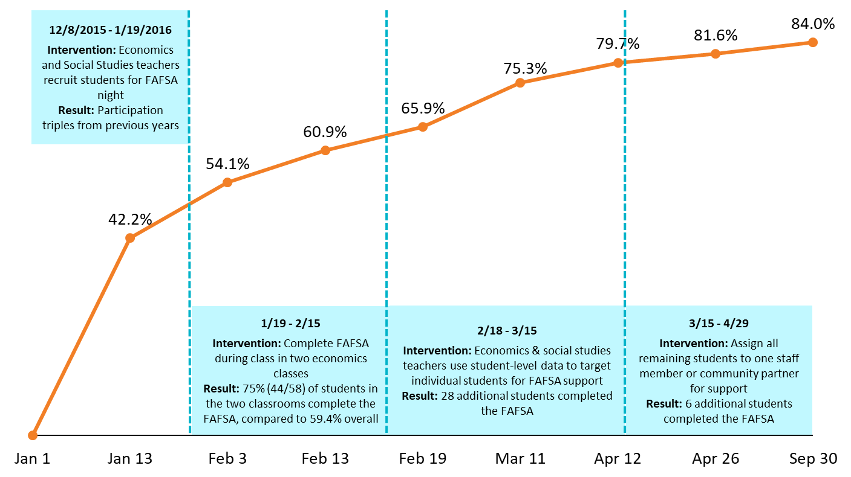
Mapping Improvement Strategies at Franklin High School
(Using School-level Data)
Source: Numerator comes from FAFSA + through the Office of Student Access and Completion, includes Oregon Student Aid Application (ORSAA) completers (provided by school), denominator is January 1st enrollment

Slide 13




FAFSA Completion Best Practices
Practice 1: Use Current Student-Level Data
Practice 2: Involve Community Partners
Practice 3: Involve Teachers & Staff
Practice 4: Do FAFSA During Class Time

Slide 14
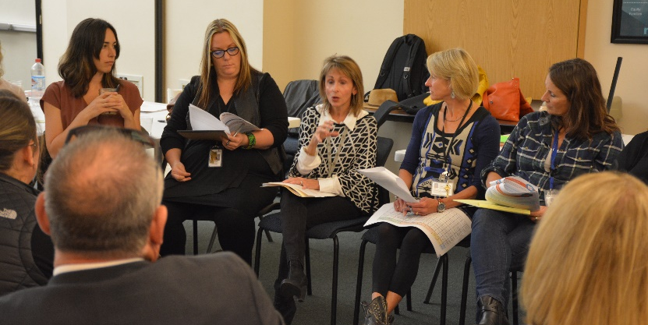
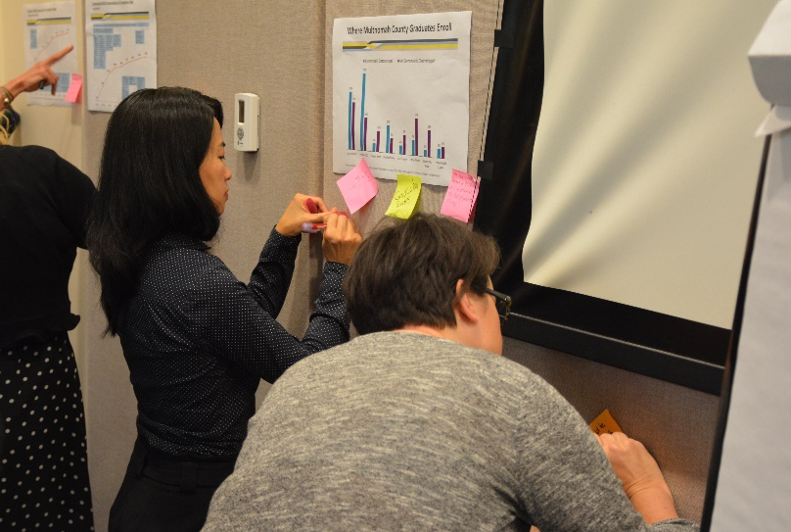
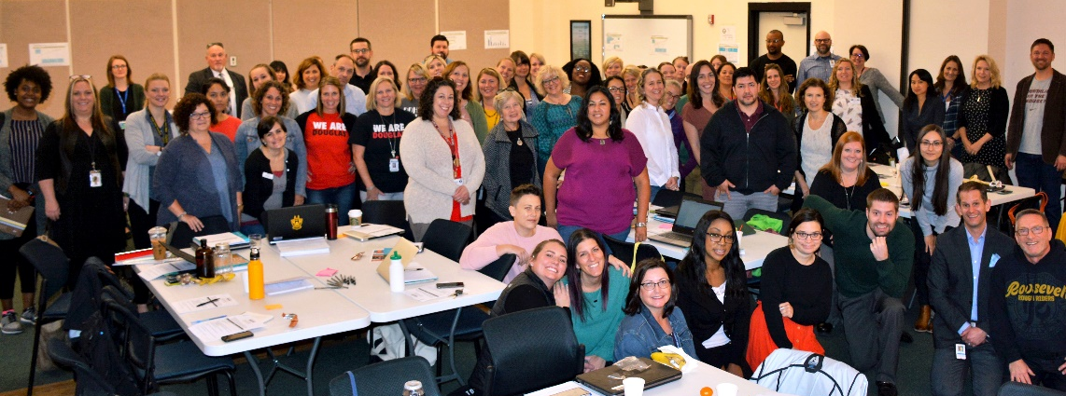
Shared Learning Across Districts

Slide 15
County-Wide FAFSA Completion Rates

Slide 16
Where Do Franklin Grads Enroll?
Percentage of Students who Enrolled within 4 Months of Graduation, Class of 2016

Slide 17
Post-Secondary Enrollment Rate
Percentage of Students who Enrolled within 16 Months of Graduation

Slide 18


Bridging the Gap
High School
Post-Secondary

Slide 19


Bridging the Gap
High School
Post-Secondary

Slide 20
All Hands Raised & Portland Public Schools
Highlights from a Decade of Partnership
PARTNERING FOR COLLECTIVE IMPACT
Facilitated 6 Site Teams over the last 5 years driving measurable improvement in student outcomes
Coordinated Ninth Grade Counts network of summer transition programs serving 4,000+ PPS students over 10 years
Released Four Chapters highlighting data and collaborative action county-wide
Showcased PPS achievements in national StriveTogether Cradle to Career Network, building on PPS’s racial equity leadership
PORTLAND PUBLIC SCHOOLS FOUNDATION & THE PPS PARENT FUND
Managed $33.6 million raised by PPS Parents through Local School Foundations
Distributed $10.5 million directed through 448 PPS Parent Fund Awards to PPS Schools
Provided $1.4 million of in-kind services to PPS parents & schools

Slide 21
Questions?
@allhandsraised

